Slide 1
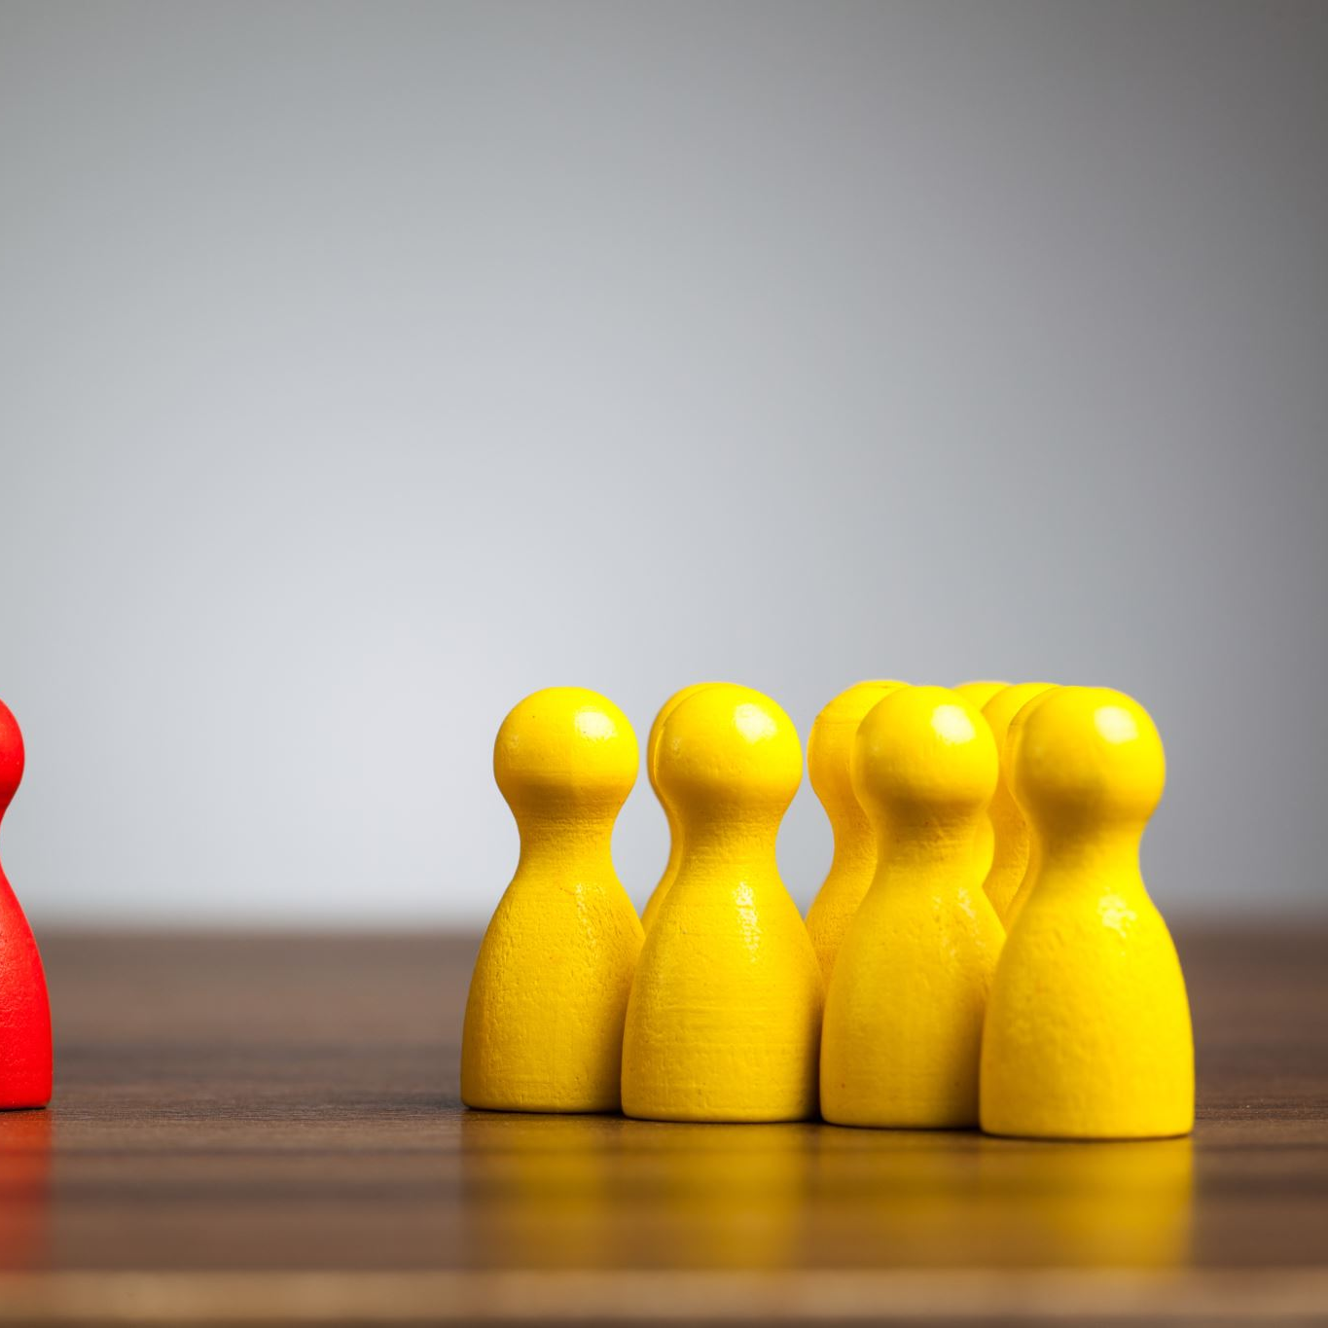

PRINCIPLES OF LEADERSHIP TRAITS AND BEHAVIORS APPROACH TOWARDS LEADERSHIP
SPRING 2023
LECTURE 02
FAREED QURESHI

Slide 2
SESSION LEARNING OBJECTIVES
Outline some personal traits and characteristics that are associated with effective leaders.
Know the distinction between people-oriented and task-oriented leadership behavior and when each should be used.
Distinguish among various roles leaders play in organizations, including operations roles, collaborative roles, and advisory roles, and where your strengths might best fit.

Slide 3
INTRODUCTION TO TRAITS THEORY
Differentiates leaders from non leaders by focusing on personal qualities and characteristics
Trait theory of leadership sought personality, social, physical and intellectual traits
Assumes that leaders are born

Slide 4
MAJOR LEADERSHIP TRAITS
INTELLIGENCE | INTEGRITY
SELF-CONFIDENCE | SOCIABILITY
DETERMINATION

Slide 5

INTELLIGENCE
Intelligence →
Leaders tend to have higher intelligence than non leaders
Strong verbal ability, perceptual ability and reasoning
Having an IQ higher than followers, good or not ?
Steve Jobs
Intelligence is a trait that helps in gaining certain skills
ذہانت

Slide 6

SELF-CONFIDENCE
Self-confidence →
Ability to be certain about one’s competencies and skills
Self-esteem and self-assurance
Why is it important for a leader ?
A belief that one can make a difference
Steve Jobs
خود اعتمادی

Slide 7
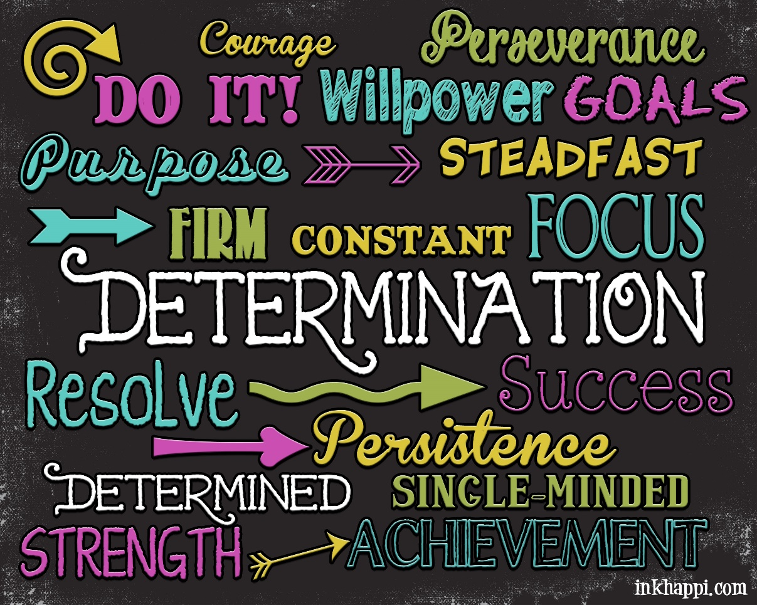
DETERMINATION
Determination →
Desire to get the job done
Initiative, persistence, dominance, and drive
Willing to assert themselves
Proactive
Capacity to persevere in the face of obstacles
Why is it important for leaders ?
عزم

Slide 8
INTEGRITY
Integrity →
The quality of honesty and trustworthiness
Adherence to strong set of principles and take responsibility for their actions
Why is integrity important for leaders ?
Inspire confidence
They can be trusted to do what they say they are going to do
Loyal, dependable and not deceptive
Integrity make s a leader believable and worthy of our trust
راست بازی

Slide 9
SOCIABILITY
Sociability →
Inclination to seek out pleasant social relationships
Friendly, outgoing, courteous, tactful, and diplomatic
زبان کا تھوڑا تلخ ہے لیکن دل کا بہت اچھا ہے, what do you think ?
Sensitive to others’ needs
Show concern for their well being
Good interpersonal skills
Create cooperative relationships with their followers
ملنساری

Slide 10

EMOTIONAL INTELLIGENCE
Emotions (affective domain) and thinking (cognitive domain) and the interplay between the two
Intelligence – ability to learn information and apply it to life tasks
Emotional intelligence – ability to understand emotions and apply this understanding to life tasks
“the ability to perceive and express emotions, to use emotions to facilitate thinking, to understand and reason with emotions, and to effectively manage emotions within oneself and in relationship with others.”
Consists of personal and social competencies (Goleman, 1995, 1998)
Personal – self-awareness, confidence, self-regulation, conscientiousness, and motivation
Social – empathy, communication skills, conflict management

Slide 11
INTRODUCTION TO BEHAVIORAL APPROACH
Traits approach – personality characteristics of the leader
Skills approach – the leader’s capabilities
Behavioral approach – focuses exclusively on what leaders do and how they act
Expanded leadership research to include the actions of leaders towards followers in various contexts.
Leadership is composed of two general kinds of behaviors:
Task behaviors – facilitate goal accomplishment
Relationship behaviors – help followers feel comfortable with themselves, with each other, and with the situation
Behavioral approach explains how leaders combine these two kinds of behaviors to influence followers

Slide 12
BLAKE AND MOUTON’S MANAGERIAL GRID

Slide 13
MINTZBERG LEADERSHIP ROLES
Discovered ten leadership roles
Separated into three groups:
Interpersonal
Informational
Decisional

Slide 14
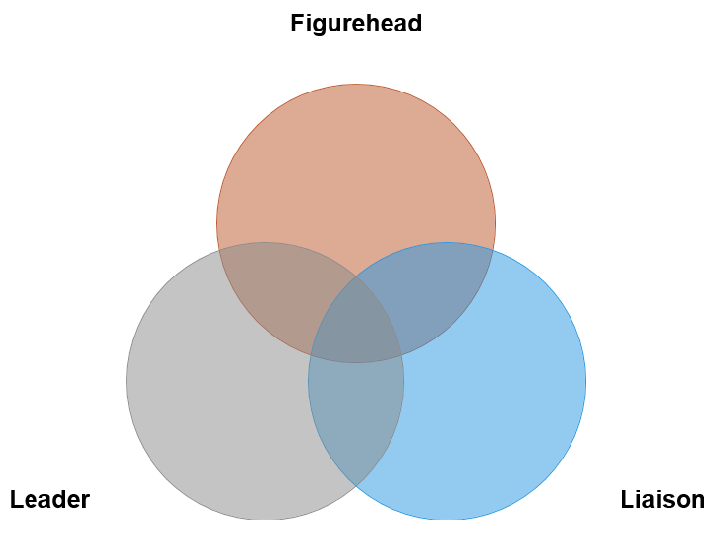
MINTZBERG LEADERSHIP ROLES: INTERPERSONAL

Slide 15
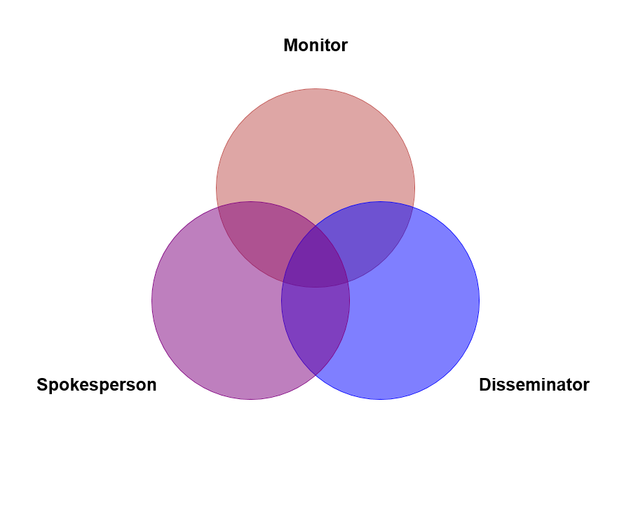
MINTZBERG LEADERSHIP ROLES: INFORMATIONAL

Slide 16
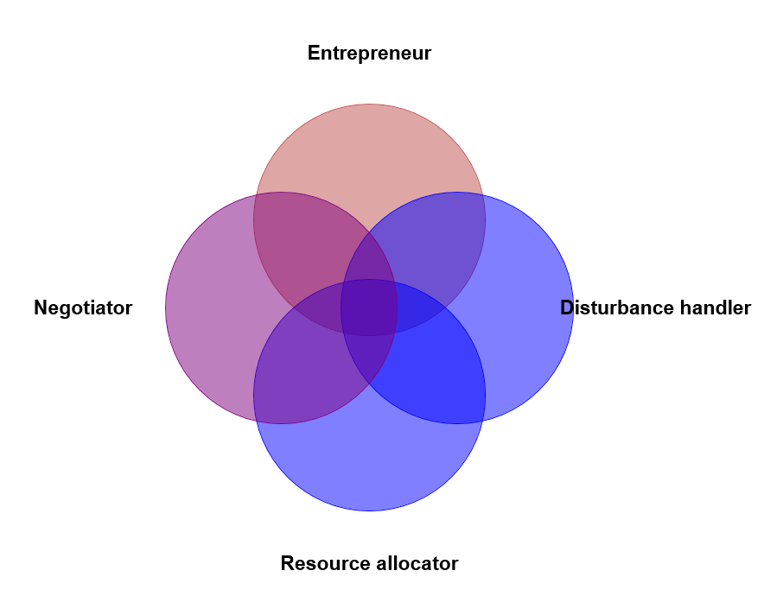
MINTZBERG LEADERSHIP ROLES: DECISIONAL

Slide 17
THAT IS ALL FOR TODAY !!

